Slide 1
Assignment Paraphrasing
Plagiarism is a serious Issue!!!
Please also check on Canvas Announcements
When preparing your TMA, GBA, or any written assignment reports, it is important to note the following:
Avoid copying assignment questions into your assignment report. This is to avoid increasing the Turnitin score of the report.
Avoid copying an entire article into your report as supplementary documents unless you are specifically told to do so.
Avoid patchwriting; and please see the following link for details: https://awelu.srv.lu.se/academic-integrity/plagiarism/different-kinds-of-plagiarism/patchwriting/
Note that marks will be deducted for poor paraphrasing and serious cases will be referred to the exam departments for further investigations.
e.g., Give pertinent comments to the codes
[#What is this line (or a few lines of codes) used for?]

Slide 2
Study Unit 6 Basic SQL in Python

Slide 3
Introduction to SQL and SQLite3

Slide 4
Introduction to SQL and SQLite3
SQL (Structured Query Language) is a programming language designed for database management.
In Python, the SQLite3 package allows us to embed SQL codes in Python programs to facilitate connections to databases and query data in it.
SQLite3 is a built-in package of Python. Hence, no installation is needed.
SQLite3 works hand-in-hand with the pandas packages since both of them are designed for data management.
We can convert output tables of SQL queries to pandas DataFrames and vice versa anytime.

Slide 5
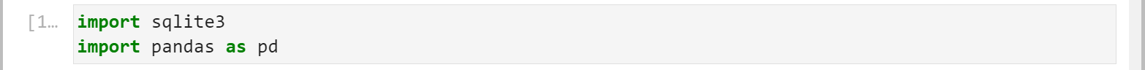
Import SQLite3
Use the import syntax to load sqlite3 into the program.
Import sqlite3 and pandas:
import sqlite3

Slide 6
Creating Data Files in Python (I)
Data entered by users at runtime can be stored in, e.g., .csv text files. Text files are good medium of data storage due to high compatibility.
Almost every software such as Excel, SPSS, SAS, etc. has a module to convert text files into their own data file format.
Text files are also the most suitable format for data exchange since their size is usually small so that they can be uploaded and downloaded easily.
To store data in a text file, we need to open it with open() first.
The with statement is used in combination with the open() function.
Data in the text file will be stored in file_object for further processing.
with open("file_name", mode = "mode_str") as file_object: instructions

Slide 7
Creating Data Files in Python (II)
We can also choose the permitted operations that we can carry out with the file. Here is a list of some of the available modes:
Character | Description
"r" | open for reading (default)
"x" | open for exclusive creation, failing if the file already exists
"w" | open for writing, truncating the file first
"a" | open for writing, appending to the end of the file if it exists
"+" | open for updating without truncation (reading and writing)

Slide 8
Work with Text File Data
Write the user-entered data to the text file with .write().
After all data have been saved to the file_object, we need to close the file properly to release its access to other parties.
Use a for-loop to go through the existing entries in a text file line by line and print the content to the screen.
file_object.write(data_row)
file_object.close()
for line in file_object: print(line)

Slide 9
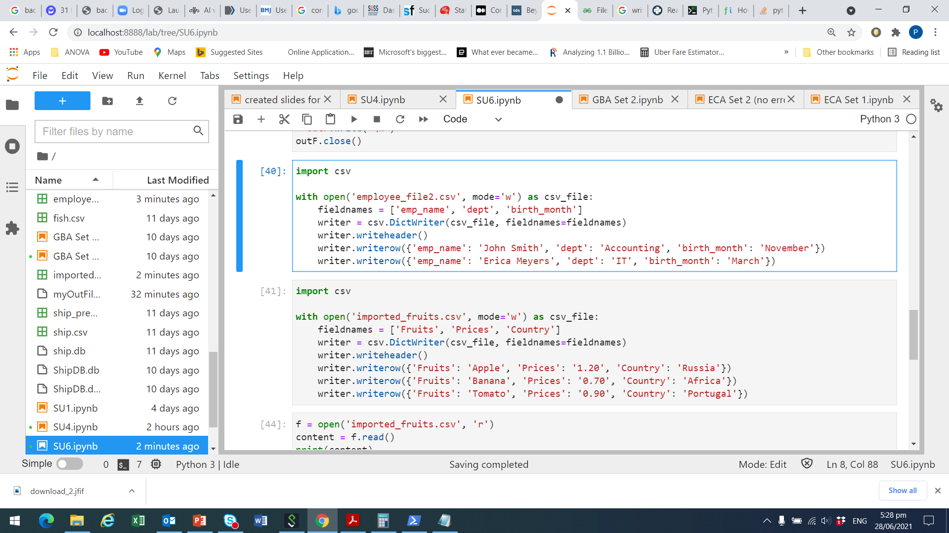
Example: Open and Write (I)
First import csv module as we are creating a csv object
Next, open a new file which is saved as ‘imported_fruits.csv’ on our computer, choose mode = ‘w’ for writing, and name the object as ‘csv_file’
Create the variable names, which is stored in the list fieldnames
Write the data as a dictionary, with the variable names defined earlier

Slide 10
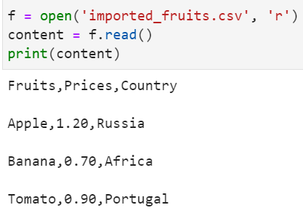
Example: Open and Write (II)
Fill in the data entries for our fruits, prices, and countries
Check if the csv is correctly created, by opening, reading and printing it

Slide 11
Connect Python to Database
First, generate a “connection” from Python to the databases by the connect() function of the sqlite3 package.
Then, create SQL syntaxes as strings or string variables in Python and send them to SQL for execution by a cursor object.
The cursor object is created by the .cursor() method.
connection_object = sqlite3.connect("database_name")
cursor_object = connection_object.cursor()

Slide 12
Export Data to Database
To create a table from a .csv file, read in the file as a pandas database in Python first, then send the data object to the database by .to_sql().
We can choose to replace ("replace"), append ("append"), or let Python create an error message ("fail") if a table already exists in the database.
data_object = pandas.read_csv("csv_file_name.csv")
data_object.to_sql("table_name", connection_object, if_exists)

Slide 13
Query Data from Database
Execute SQL commands through the cursor object with .execute().
Send a SELECT statement to SQL to select a table from the database.
Once a table is selected, we can print one record of the result to the screen by the .fetchone() method.
Use the .fetchall() method to print all records from a query result.
After applying .fetchone() or .fetchall(), records are no longer available.
cursor_object.execute("SQL_command_string")
SELECT * FROM table_name;
cursor_object.fetchone()
cursor_object.fetchall()

Slide 14
Activity 1
Car sales program:
Carry out the following tasks in JupyterLab:
Write a program that the user can enter the brand, model, buying price and satisfaction rate (1 = “totally dissatisfied”, …, 5 = “totally satisfied”) of the car purchased.
Save the input as “car_purchase” in a text file (preferably .csv file).
Create a database and export the data to it.
Export the original data of “car_model.csv” and “car_price.csv” to the database as well.

Slide 15
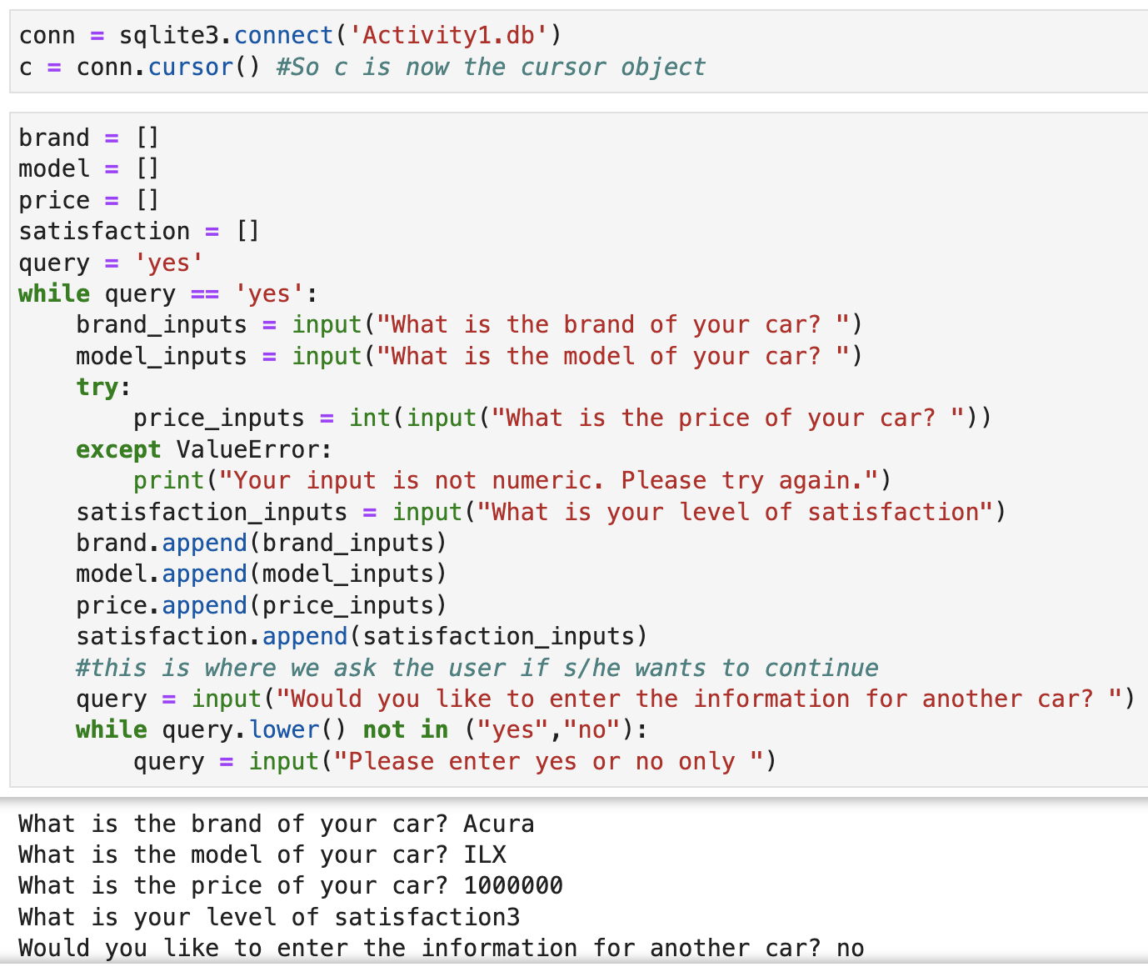
Activity 1 (Answers)

Slide 16
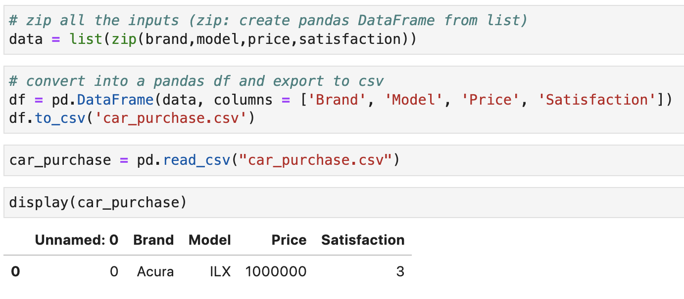
Activity 1 (Answers)

Slide 17
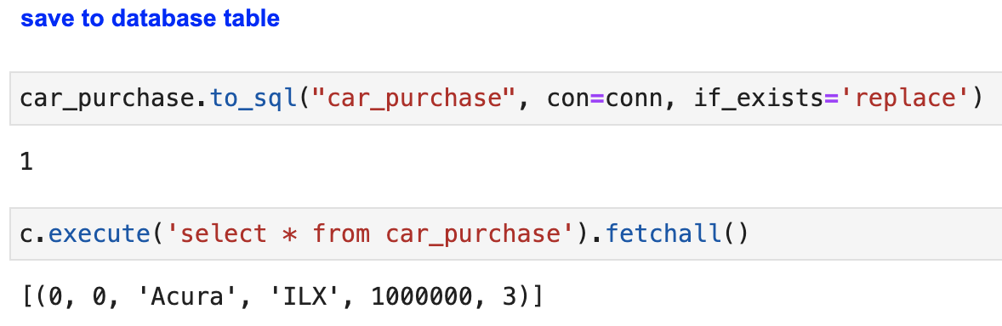
Activity 1 (Answers)

Slide 18
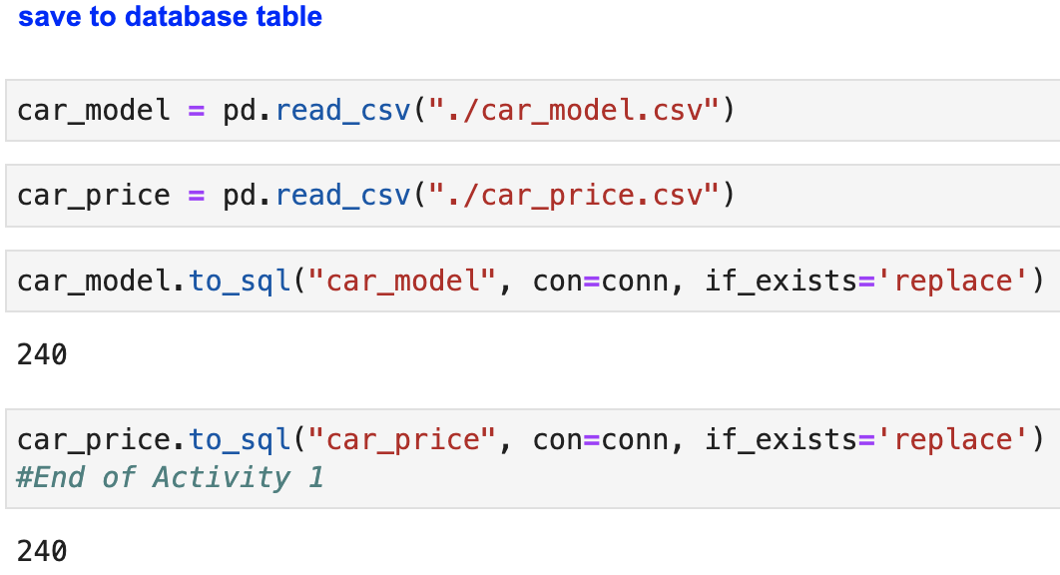
Activity 1 (Answers)

Slide 19
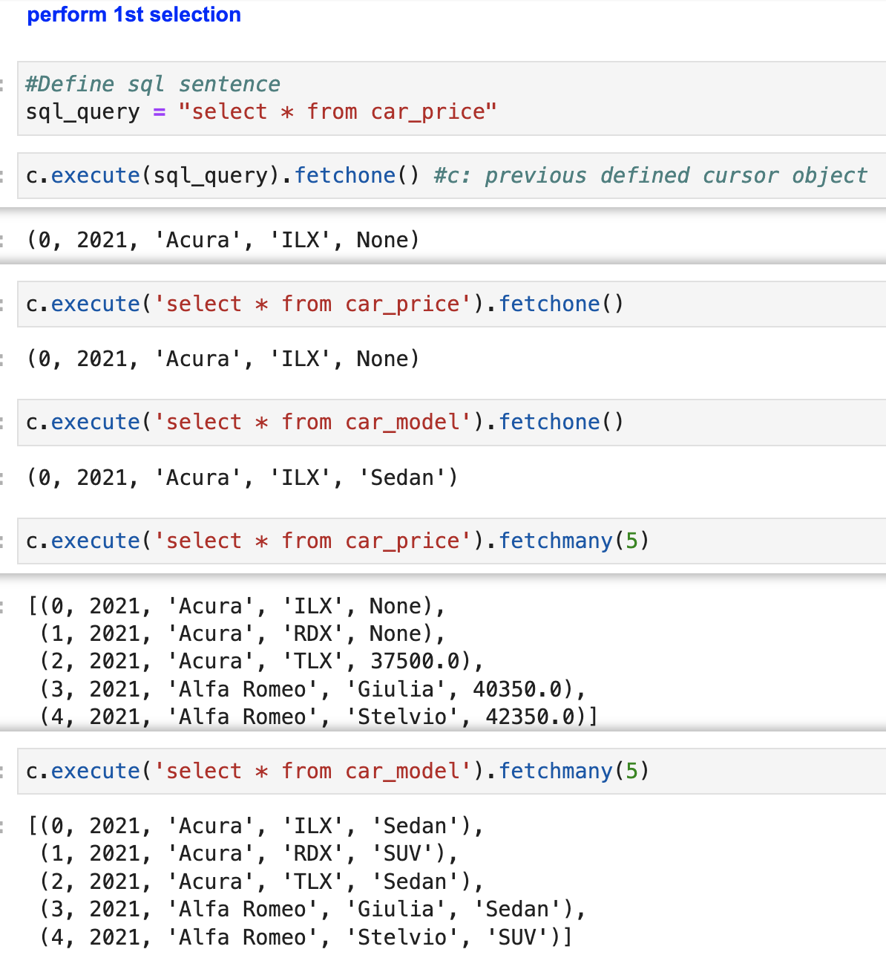
Activity 1 (Answers)

Slide 20
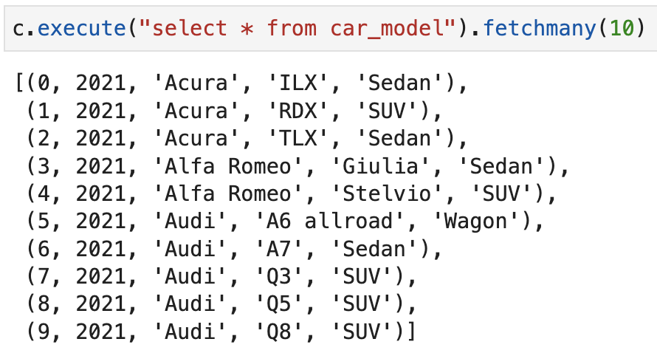
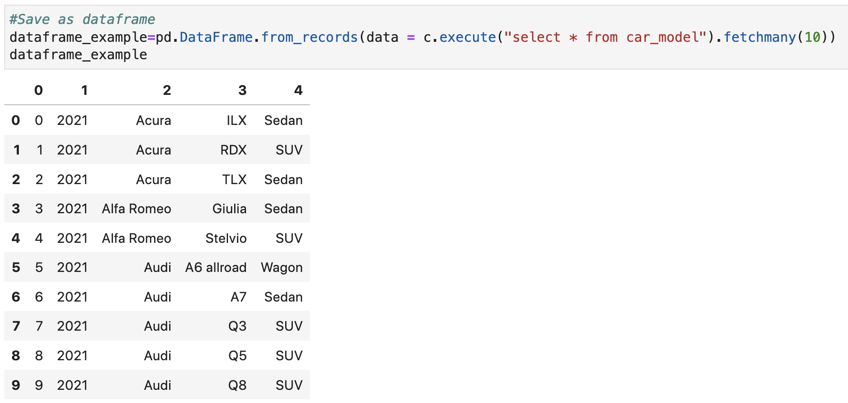
Activity 1 (Answers)

Slide 21
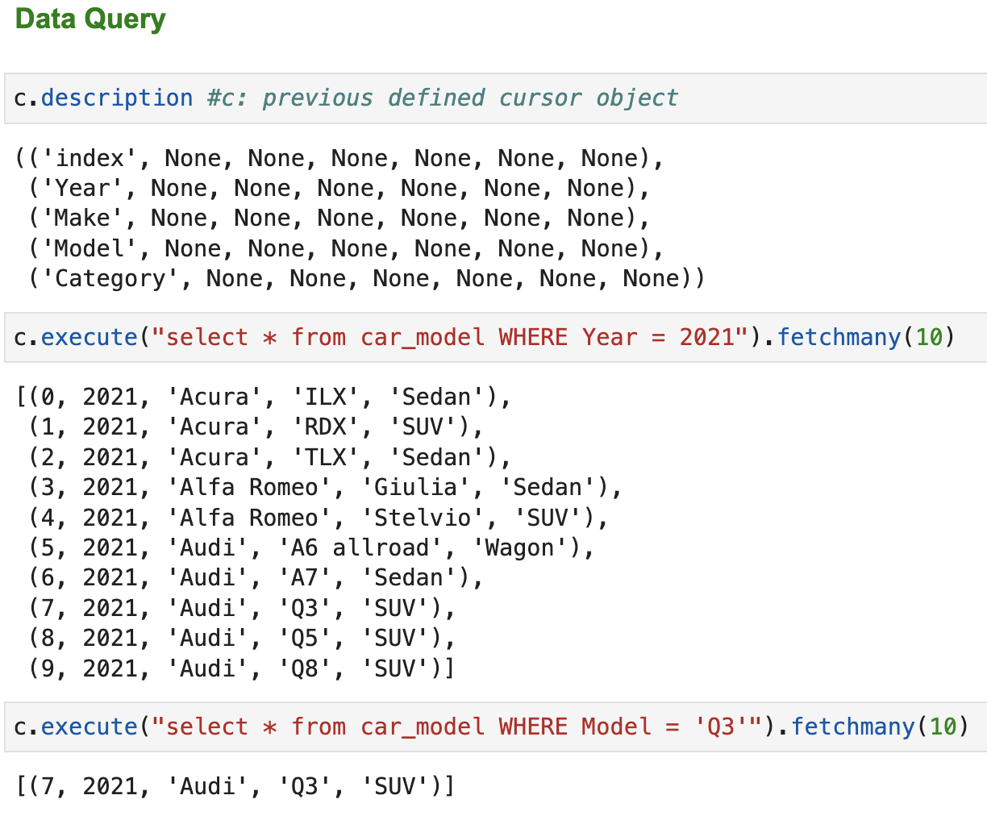
Activity 1 (Answers)

Slide 22
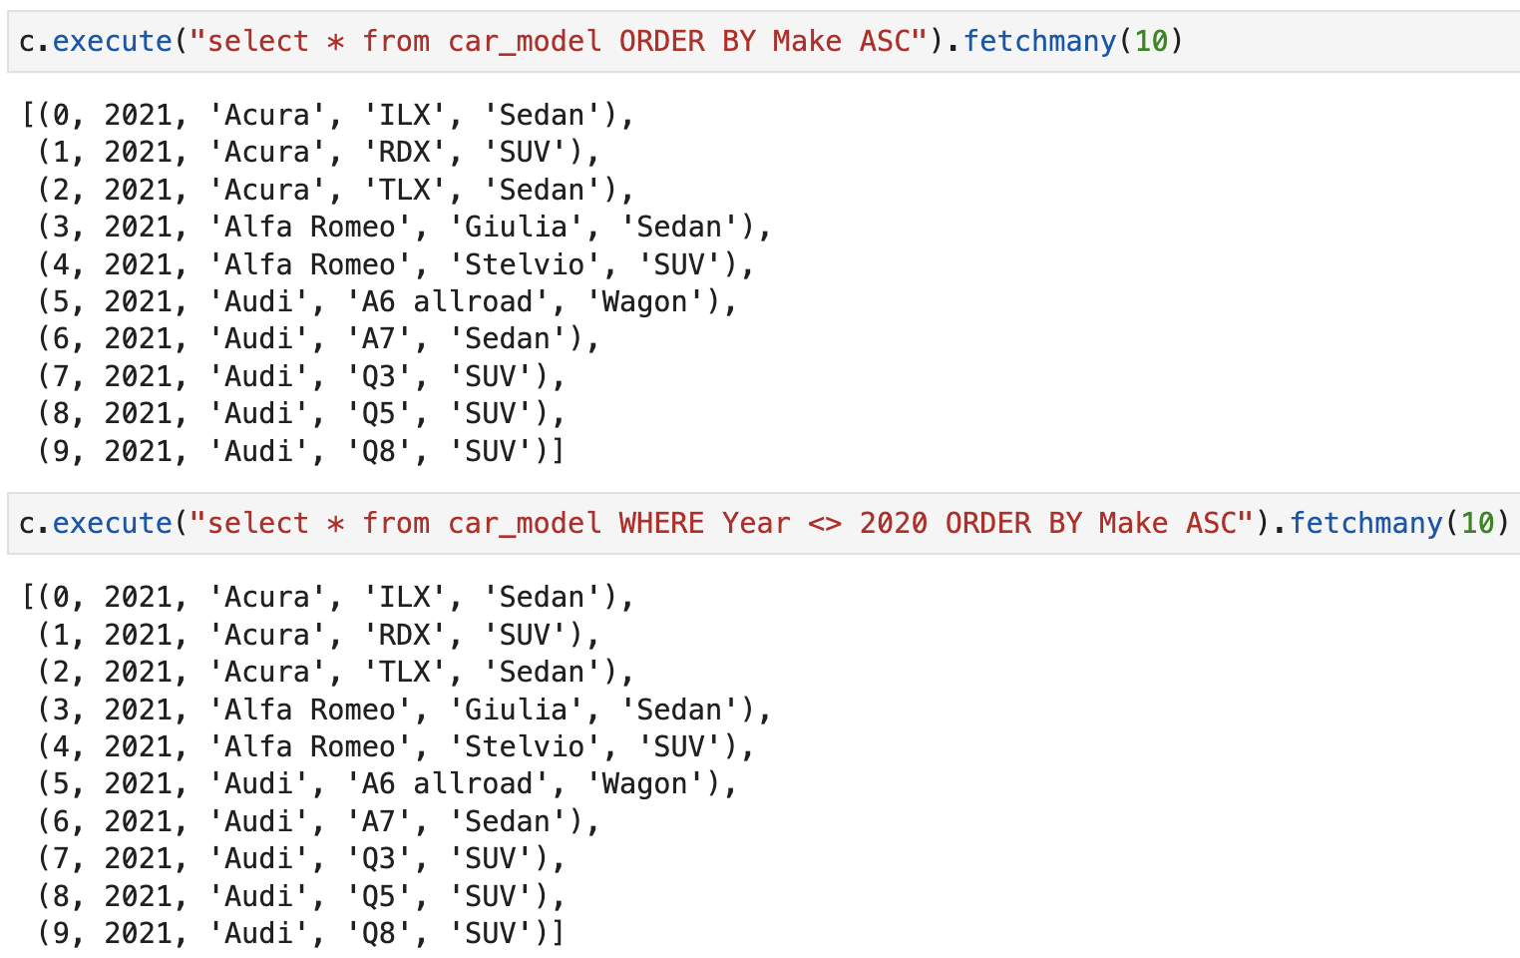
Activity 1 (Answers)

Slide 23
Discussion
Why is .csv file a good medium of data storage in comparison to other formats?
What are the components of the SQLite3 package which regulate the “communication” between a Python program and a database?

Slide 24
Discussion (answer)
Why is .csv file a good medium of data storage in comparison to other formats?
Save memory
What are the components of the SQLite3 package which regulate the “communication” between a Python program and a database?
Connection: open a connection from Python to the database
Cursor object: execute commands on the database

Slide 25
Data Query

Slide 26
Extract Variable Names from a Table
The SELECT statement also allows us to select some of the variables from the table instead of all of them.
But in some cases, we may not even know the variables that the table contains or how their names are correctly spelt.
We can use .description to extract the variable from the last queried table.
The returned object is a collection of tuples where the first item of each tuple is the column name, and the last six items are None.
cursor_object.description

Slide 27
Store Query Result as DataFrame
It may be desirable to store the result of an SQL query in a pandas DataFrame. In fact, we can use .from_records() for this purpose.
The .from_records() method is actually created to convert structured or n-dimensional record arrays to pandas DataFrames.
We can specify our own column names of the output DataFrame. If not, the corresponding column names are simply the column indices.
query_object = pd.DataFrame.from_records (data = cursor_object.fetchall(), columns)

Slide 28
Sort Data
We can add the keyword ORDER BY to the SELECT statement to sort the data of a table by some of its variables.
To sort a table by multiple variables, separate their names by commas.
The sequence of the sorting variables reflects the sorting hierarchy.
To sort in descending order by a particular variable, specify the DESC option behind the variable name.
SELECT * FROM table_name ORDER BY var1_name, var2_name ASC|DESC

Slide 29
Filter Data
More often, we do not query data of the entire table.
Instead, we are searching for records that fulfil certain criteria.
In SQL, use the WHERE clause in the SELECT statement to filter the useful records for us.
SELECT * FROM table_name WHERE var_name = value;

Slide 30
Operators in the WHERE Clause
Here is a list of the operators used in the WHERE clause:
(Source: https://www.w3schools.com/sql/sql_where.asp)
Operator | Description
= | Equal
> | Greater than
< | Less than
>= | Greater than or equal
<= | Less than or equal
<> | Not equal (In some SQL versions it may be written as !=)
BETWEEN | Between a certain range
LIKE | Search for a pattern
IN | To specify multiple possible values for a column

Slide 31
Filter Missing Data
We can connect multiple criteria in one statement by linking them with the AND, OR and NOT operators.
Sometimes, we would rather not obtain records that contain missing values in one or more variables from a query.
Use the IS NOT NULL syntax with the SELECT statement for this query.
Without the NOT operator, SQL returns all records with missing values in the variable var_name to us.
SELECT * FROM table_name WHERE var_name IS NOT NULL;

Slide 32
Select Variables from Table
We can select particular columns from a table in the data query.
The asterisk (*) in the SELECT statement is replaced by a list of selected variables in this case.
We can also create our own variable list as string in our Python program first and then combine it with the rest of the statement.
SELECT var_name1, var_name2, …
FROM table_name WHERE criteria;

Slide 33
Activity 2
Car sales program:
Carry out the following tasks in JupyterLab using SQL statements:
Select 10 records with the value “Sedan” or “SUV” in the variable “Category” from the table “car_model”.
Select 10 cars that costs more than USD 50,000.00 from the table “car_price”.
Select all records in which the users were “totally dissatisfied” (Satisfaction = 1) with the purchased cars from the table “car_purchase”.

Slide 34
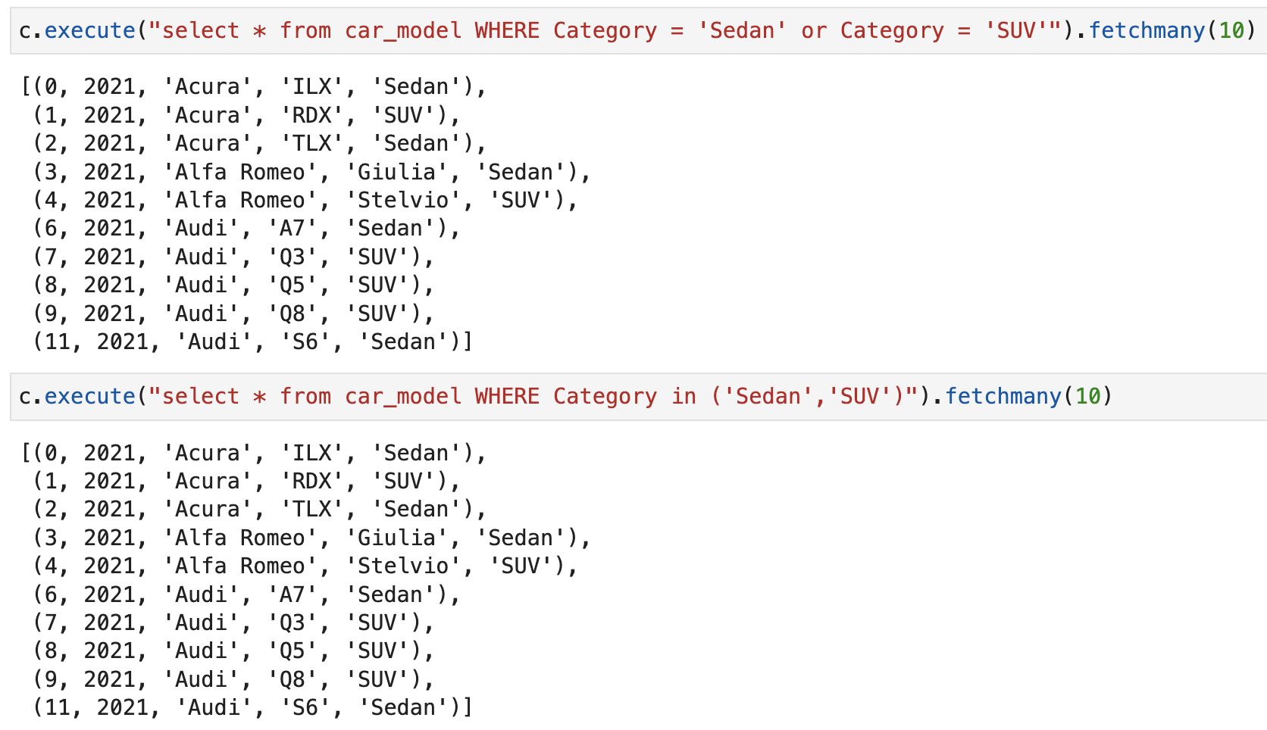
Activity 2 (Answers)

Slide 35
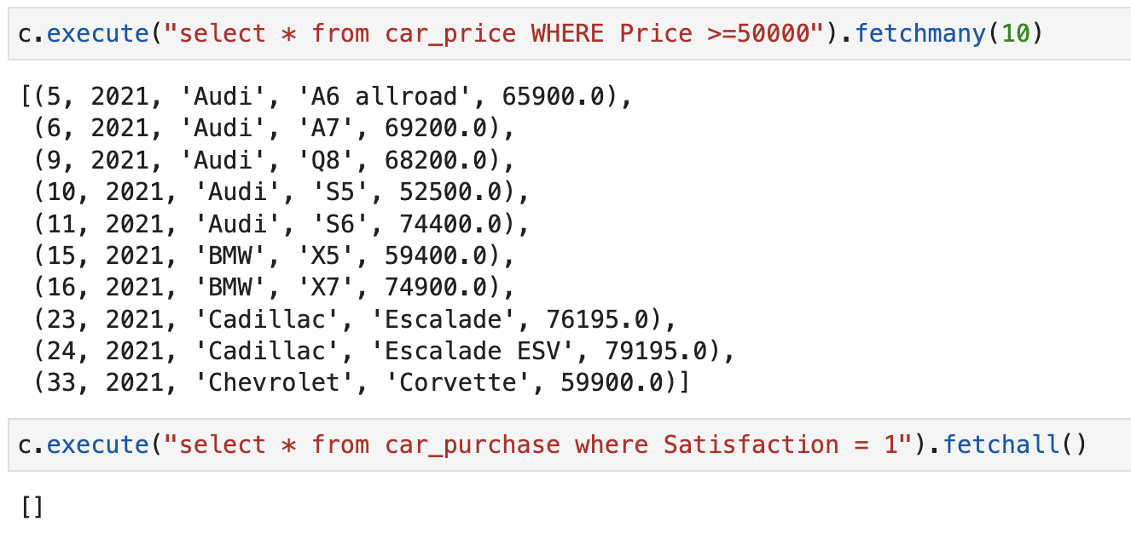
Activity 2 (Answers)

Slide 36
Join Tables

Slide 37
Natural Join
The natural join method is to join two tables with only common rows and columns in the output table.
The NATURAL JOIN clause is used within the SELECT statement.
It selects only records of table1 that can be matched by records in table2.
SQL compares the values of the matching variable from the two tables.
Note: Only one copy of each common column will be kept.
SELECT * FROM table1_name
NATURAL JOIN table2_name;

Slide 38
Activity 3
Car sales program:
Carry out the following tasks in JupyterLab using SQL statements:
Natural join the tables “car_model” and “car_price”

Slide 39
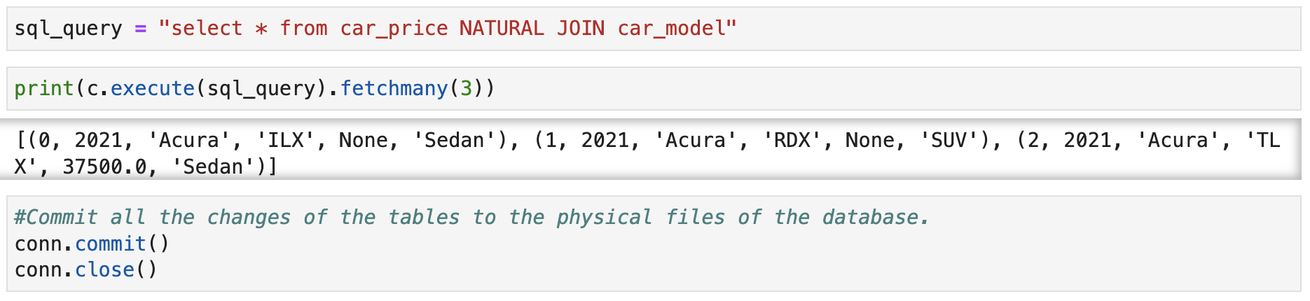
Activity 3 (Answers)

Slide 40
Online Learning Platform
SQL:
https://www.w3schools.com/sql/

Slide 41
Recap of ANL252

Slide 42
ANL 252: Python for Data Analytics
Course coverage
Study Unit | Topic
1 | Introduction to Python Programming
2 | Data Types and Functions
3 | Arrays and Plots
4 | Data Management
5 | Data Analytics in Python
6 | Basic SQL in Python
Notes:
Hello everyone, I am Siying, your lecturer for this ANL252 -- Python for Data Analytics. I am also the course coordinator. Firstly, maybe I briefly introduce myself. My Bachelor Degree was achieved in Nanyang Technological University, NTU, with first class honour. Then my PhD degree was also achieved from NTU, in the School of Civil and Environmental Engineering. I have also been a post doc research fellow in National University of Singapore, NUS, handling projects on transportation network analysis and Artificial Intelligence-based, i.e. AI-based data analytics. My major research area is data mining/data analytics and transportation, as well as maritime studies.
I am very happy to meet you all, and teach you the course on Python Programming for Data Analytics. Basically, there is something that I want to talk to you at the beginning of this lecture. I know that some of you got very good programming or coding background, as you work in the industry. On the other hand, some of you have no coding background at all. But even if your coding or programming background is not good at the current stage, there is no need to worry about it. I will try my best to take care of you and help you for this course, I want to make sure you all can understand the knowledge in this course. You can always ask me questions during the lecture or after the lecture. You can also use the zoom chat area. If you are too shy to ask questions in front of all your classmates, it is also okay. You can always email me about your question after the lecture, and I will try my best to answer your questions in time.

Slide 43
SU1: Introduction to Python Programming
Python programming environment: Jupyter Lab/Notebook
Basic arithmetic and variables
Print and input: print(), escape sequences, input()
If-elif-else-Conditions: Indentation
Loops: for-loop; while-loop
if condition 1:
instructions 1
elif condition 2:
instructions 2
else:
instructions 3
for counter in range(start, end):
instructions
while condition:
instructions

Slide 44
SU2: Data Types and Functions
Tuple: Immutable
List
Dictionary
Integrated Methods and Functions
(1) Built-in functions -- integrated in Python: e.g., print(), input()
(2) User-defined functions:
tuple_name = (element1, element2, …)
list_name = [element1, element2, …]
dictionary_name = {"key1":value1, "key2":value2, …}
def function_name(argument1, argument2, …):
instructions
return object

Slide 45
SU3: Arrays and Plots
Array Management with NumPy
Plotting with matplotlib – Data visualization
(1) Line chart
(2) Histogram
(3) Scatter plot
import numpy as np
array_name = np.array([[list1_data1, list1_data2, …],
[list2_data1, list2_data2, …], …])
import matplotlib.pyplot as plt

Slide 46
SU4: Data Management
Import data – pandas package
Data selection
(1) Select columns by variables
(2) Select rows by positions
import pandas as pd
DataFrame_name = pd.read_csv("csv_file_name.csv")
DataFrame_name[["var_name1", "var_name2", …]]
DataFrame_name.iloc[start:end]
DataFrame_name.loc[["row_label1", "row_label2", …]]

Slide 47
SU4: Data Management (Cont’d)
Merge dataframe: Append dataframe by rows; natural join
Missing data and outliers
(1) Identify/Locate missing data
(2) Delete missing data
(3) Replace missing data
(4) Outliers – Detect/remove
Data modification
(1) Sort data
(2) Grouping data

Slide 48
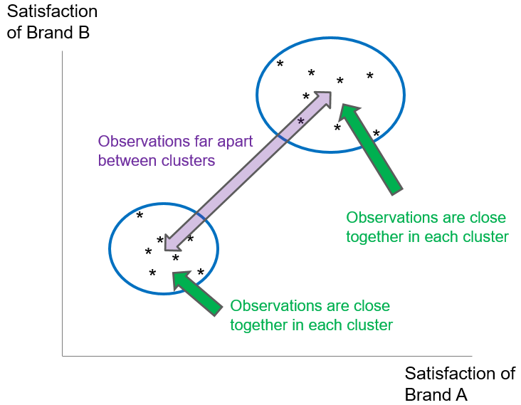
SU5: Data Analytics in Python
Introduction to Scikit-Learn
Data preparation for analytics algorithms
(1) Reduce no. of categories: .replace() method
(2) Rename variables: .rename() method
(3) Create dummy variables: get_dummies()
(4) Extract dependent and independent variables
Clustering
import sklearn
from sklearn.cluster import KMeans

Slide 49
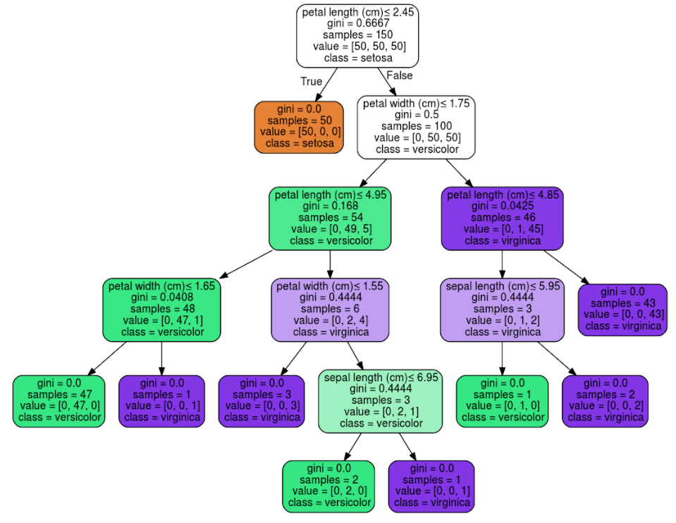
SU5: Data Analytics in Python (Cont’d)
Decision tree
from sklearn import tree
tree_Object = tree.DecisionTreeClassifier(…)
tree_Object = tree.DecisionTreeRegressor(…)
Root node; the most important feature

